Slide 1



IntellWheels:
Intelligent Wheelchair with Flexible Multimodal Interface
Luís Paulo Reis
Http://www.fe.up.pt/~lpreis
lpreis@fe.up.pt
Member of the Directive Board of LIACC – Artificial Intelligence and Computer Science Lab. Of the University of Porto, Portugal
Associate Professor of the School of Engineering, University of Minho, Portugal

Slide 2
Presentation Outline
Introduction
  Participant Institutions
  Motivation and Objectives
  Intelligent Wheelchairs
IntellWheels Project
  System Architecture
  Hardware Platform
  Multi-Agent System
  Communication Platform
  Simulation System
  Multimodal Interface
Experiments and Results
  Simulated IW Experiments
  Real IW Experiments
Conclusions and Future Work

Slide 3







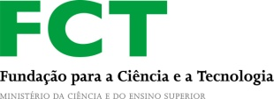

Participant Institutions
Research Labs:
  LIACC – Artificial Intelligence and Computer Science Laboratory, Univ. Porto
  INESC-P – Institute for Systems Engineering and Computers, Porto
  IEETA – Institute of Electronics and Telematics Engineering of Aveiro
Universities/Faculties:
  University of Porto – DEI/Faculty of Engineering and DEEC/Faculty of Engineering
  University of Aveiro – DETI/University of Aveiro
  University of Minho – DSI/School of Engineering
Health Institutions:
  IPP/ESTSP – Porto Polytechnic Institute/ Health Technology Superior School
  APPC – Portuguese Association for Cerebral Palsy
Funding 2010-2012 (FCT/RPID/ADA/109636/2009):
  FCT – Fundação para a Ciência e a Tecnologia
  COMPETE – Prog. Operacional Fac. Competitividade

Slide 4
Motivation
Limited mobility of certain individuals
  Increment of the population aged over 60 years
Individuals with severe physical disabilities
  Cerebral palsy
  Tetraplegia
Inability to control conventional electric wheelchairs

Slide 5
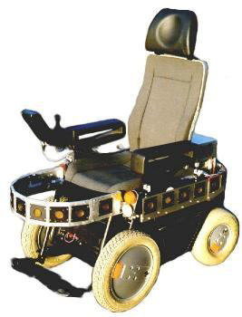
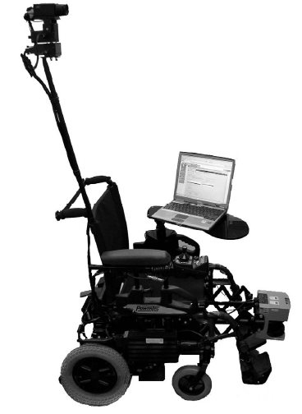
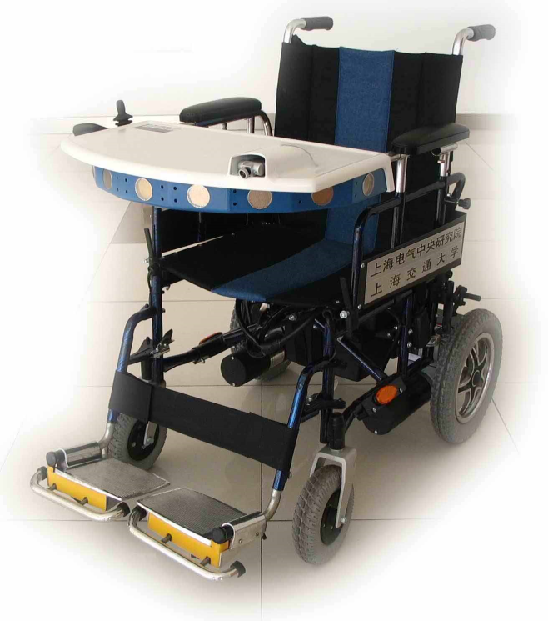
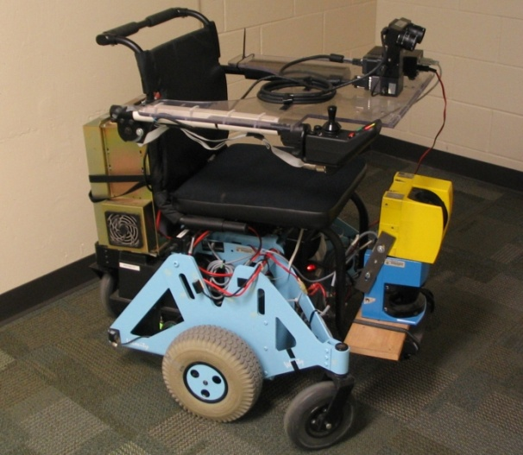
Intelligent Wheelchair
Definition:
Robotic device provided with sensorial and actuation systems and processing capabilities:
  Semi-Autonomous behavior with obstacle avoidance
  Autonomous navigation and planning capabilities
  Flexible Human-Machine interaction
  Cooperation with other IW and with other devices (e.g. automatic doors)

Slide 6
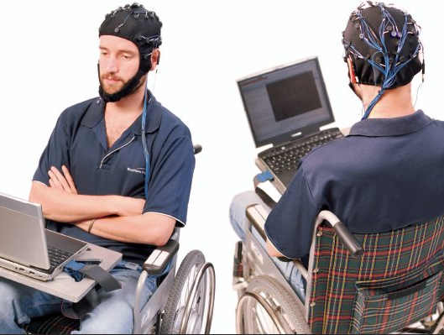
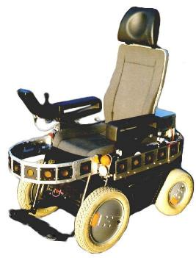
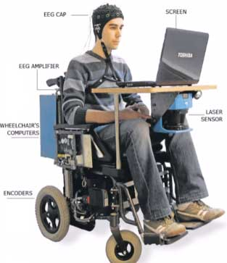
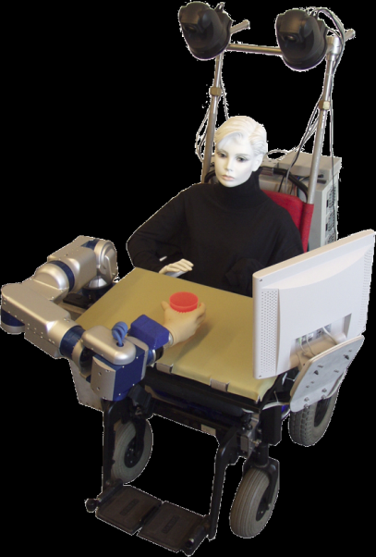
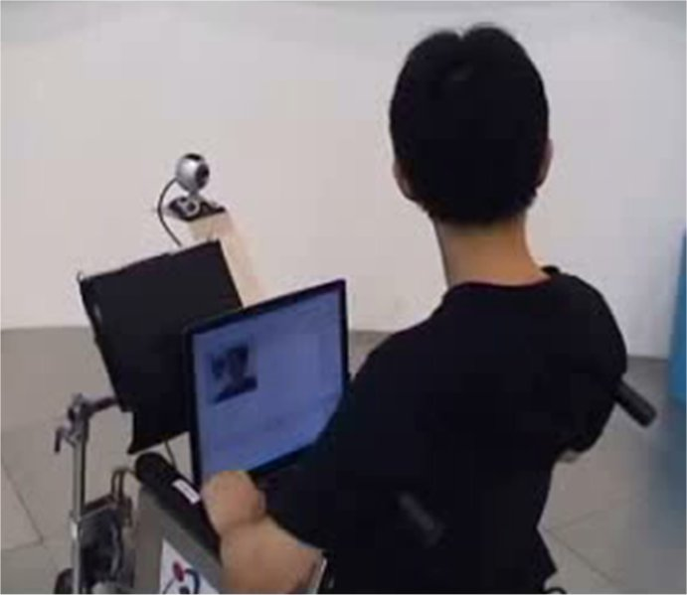
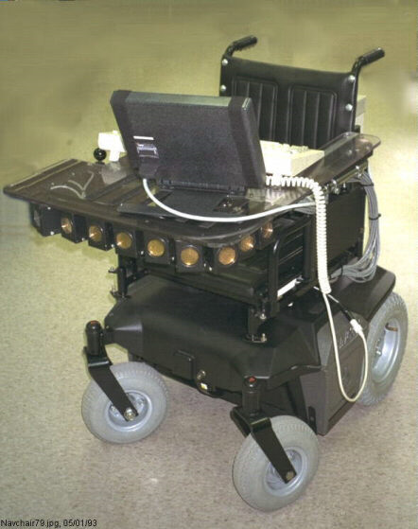
Related Work
More than 50 IW international projects
  Obstacle avoidance
  Human-machine interface
  MAS very restricted use
  IW built from scratch
Inexistence
  IW useful in practice:
    Very low cost
    Low ergonomic impact
    Useful for handicapped individuals
  Mixed reality environment
  Flexible multi-modal interface
  IW development platform
6

Slide 7
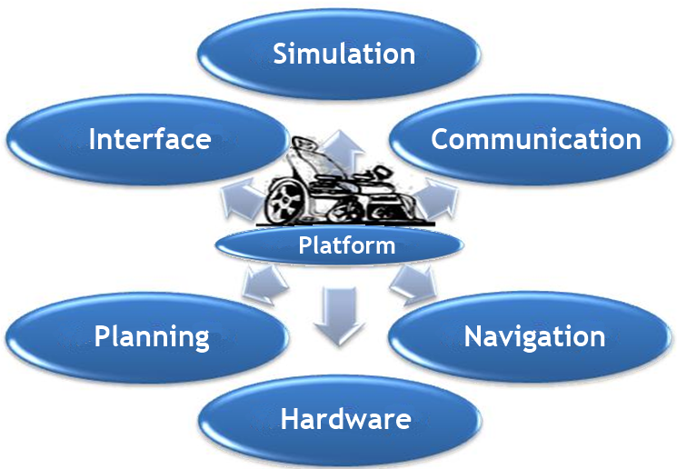
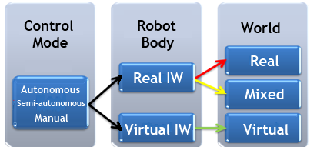
IntellWheels - Architecture
Goals
  Develop an intelligent wheelchair with generic platform kit: hardware/software
  To be mounted in commercial electric wheelchairs
  Modular architecture: Multi-Agent System
  Easy integration with new sensors, actuators and modules
  Flexible HMI (Multimodal Interface)
  High-level planning
  Simulation and Mixed-Reality
  Autonomous, shared and manual control
  Low visual and ergonomic impact and very low cost
IntellWheels modules
Control modes and possible environments

Slide 8
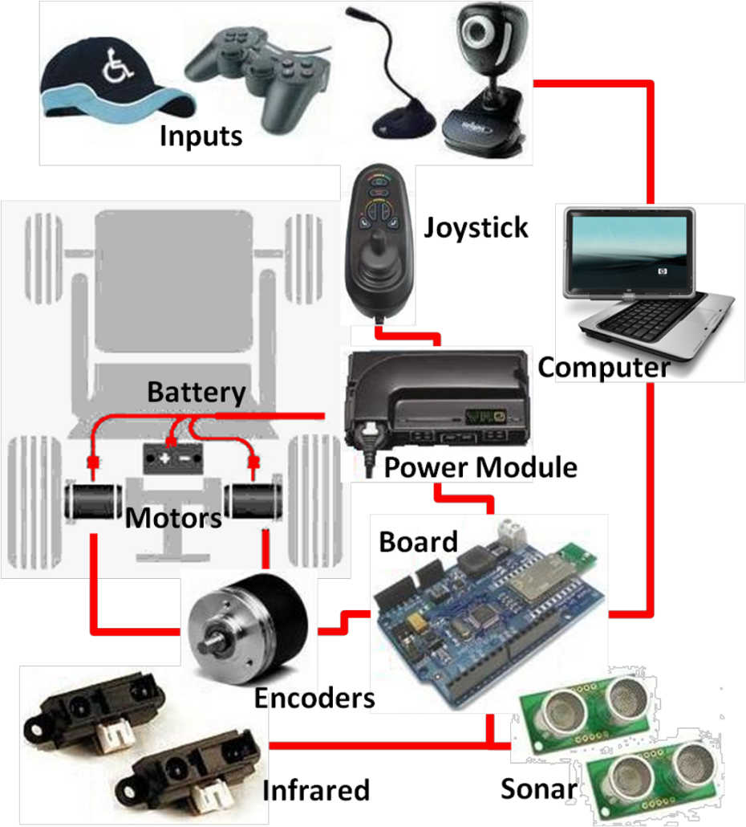
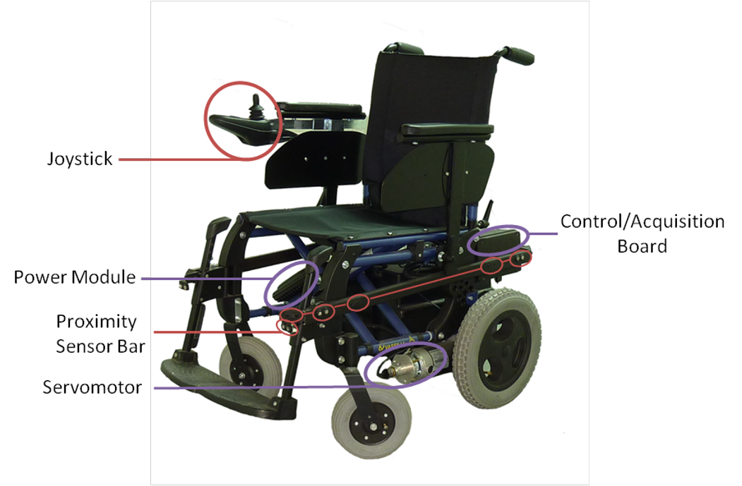
IntellWheels - Hardware
Off-the-shelf devices
    Human-machine interface
    Easy to adapt to other wheelchair models
    Powered wheelchair control
    Sensors and Processing/interface board
Basic functions developed in firmware (without PC)
    Sensor reading
    Pre-processing odometry
    Obstacle avoidance

Slide 9
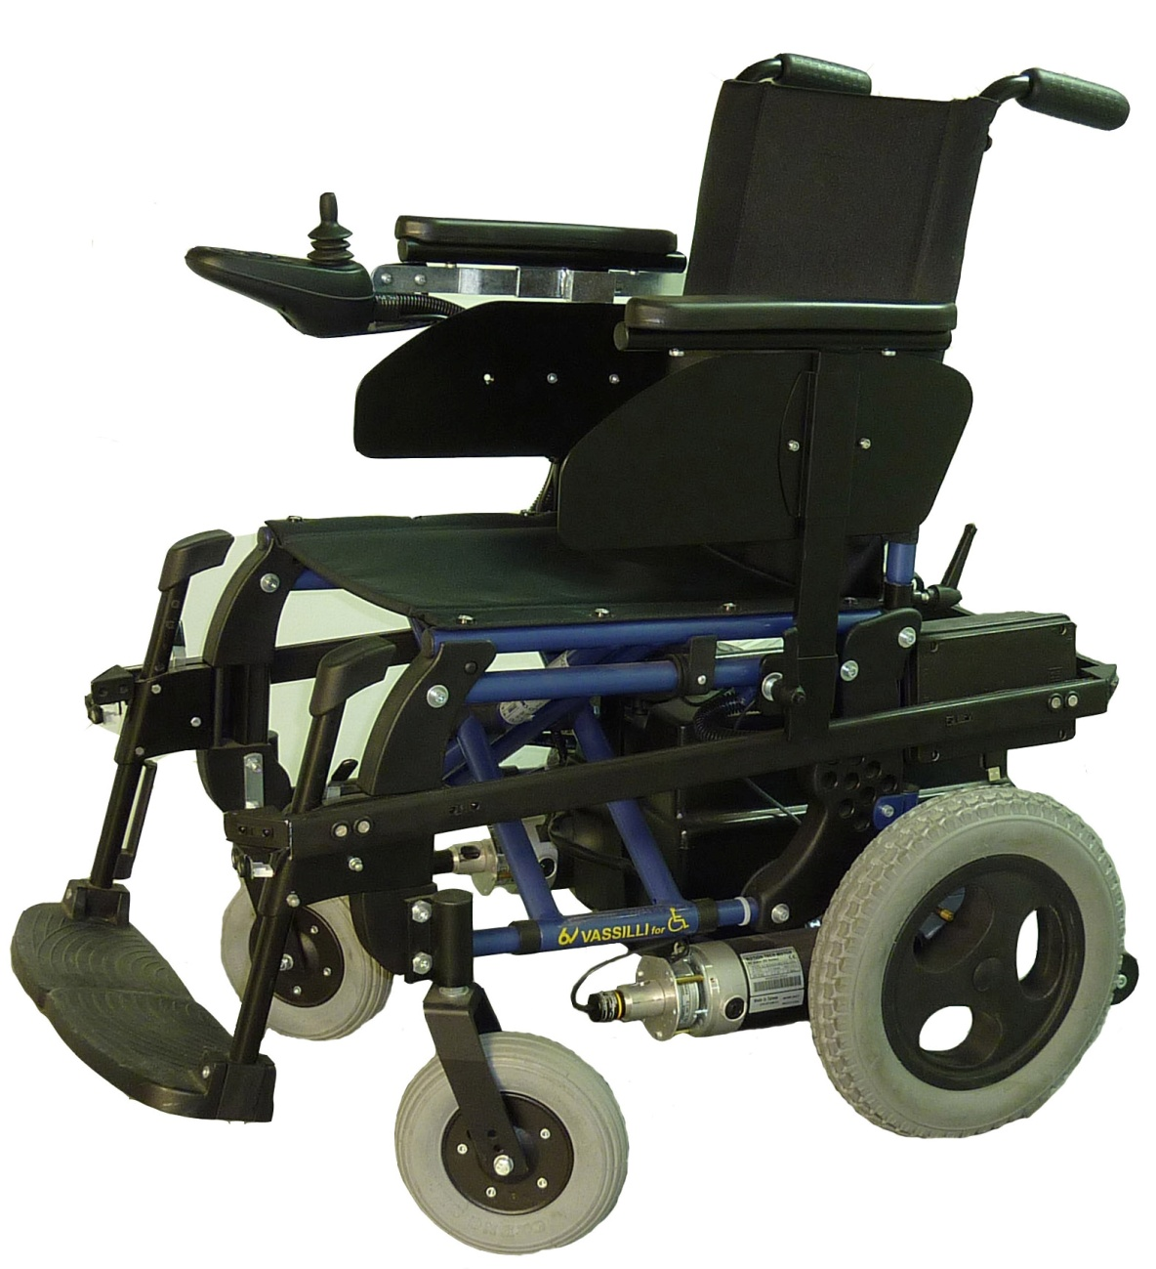
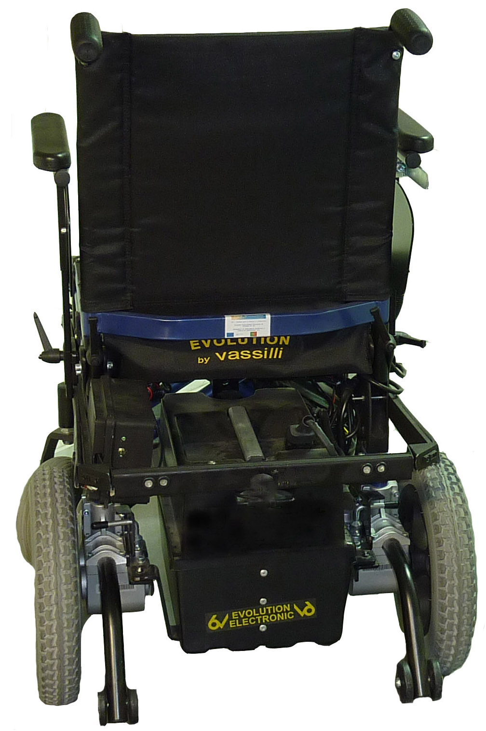
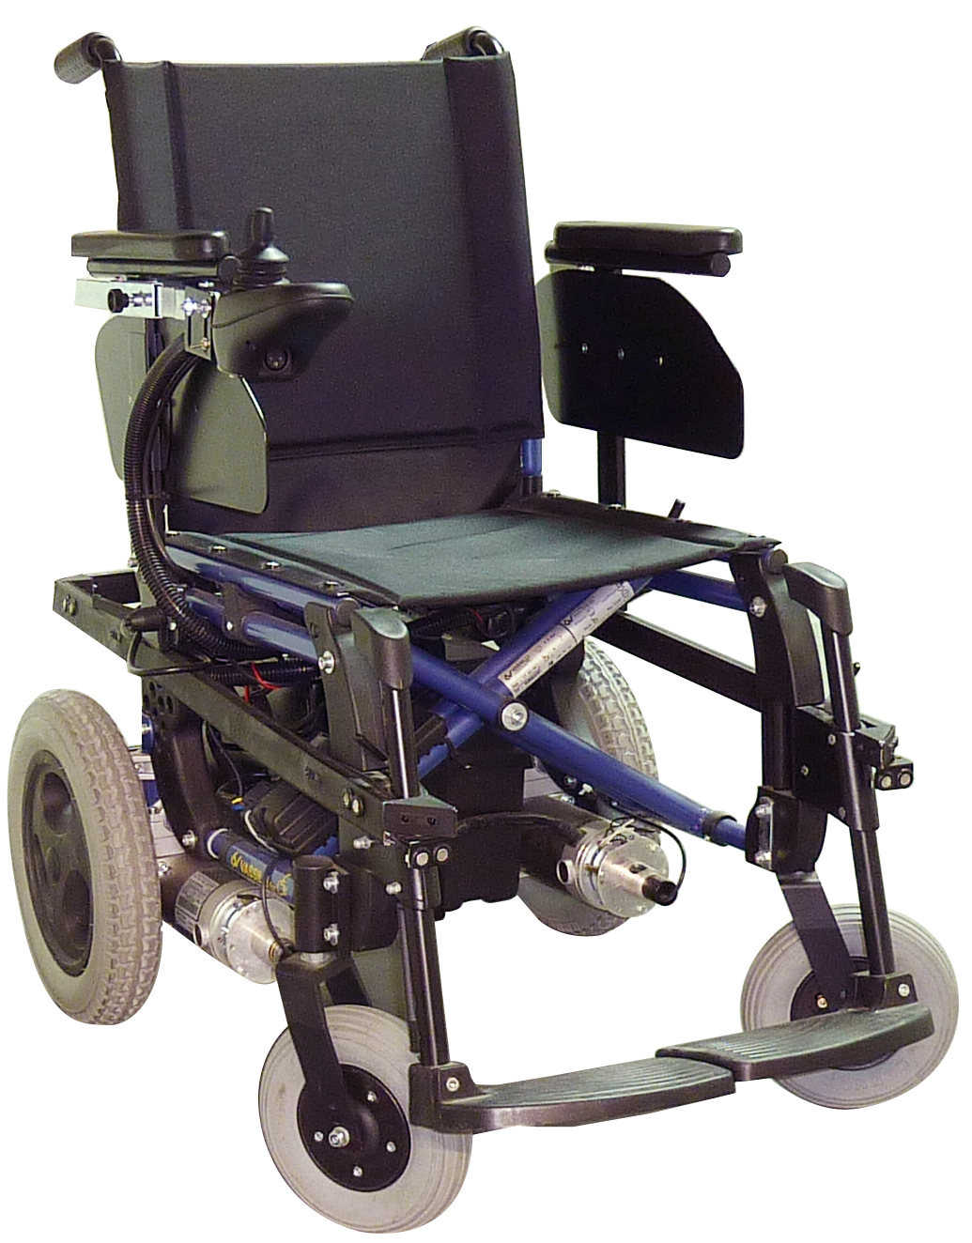
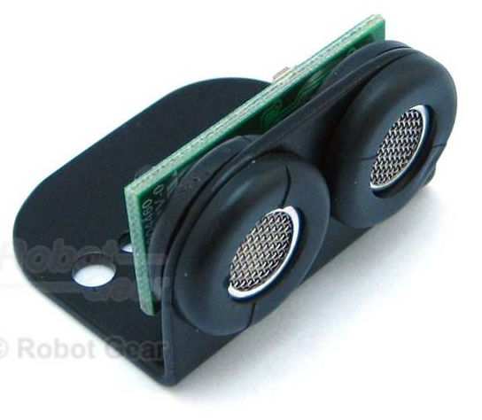
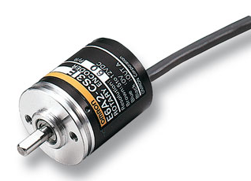
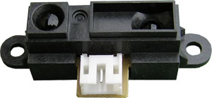
IntellWheels - Hardware
Left Side
Right Side

Slide 10
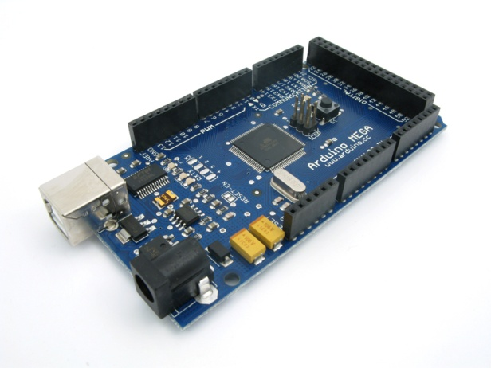
IntellWheels - Hardware
Left Side
Right Side

Slide 11
IntellWheels - Hardware
Left Side
Right Side

Slide 12
IntellWheels - Hardware
Left Side
Right Side

Slide 13
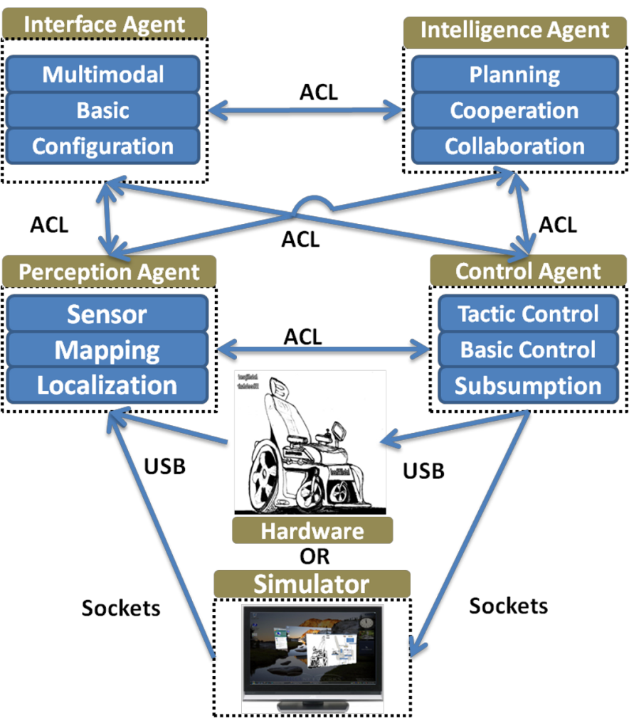
IntellWheels Software/MAS
    Multi Agent approach
    Interaction, communication, redundancy
    Easy to add new functionalities
Hardware module
  Electric wheelchair, sensors, actuators, microprocessor, PC
Simulator module
  Virtual environment and mixed reality
Control Agent
  Low-level control algorithms
Perception Agent
  Sensors, mapping and localization
Intelligence/Cognitive Agent
  High-level decision, planning and cooperation
Interface Agent
  Interprets user’s inputs into high level commands

Slide 14
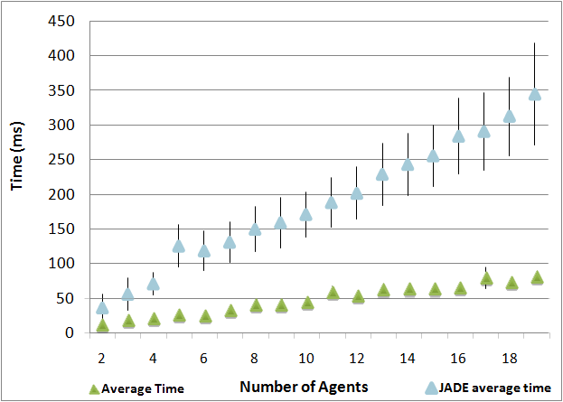
IntellWheels Communications
Communication layer
  Messages’ reception and sending
  Lowest level defenses
Security layer
  Messages integrity
Temporal layer
  Filters messages with temporal window
  Clock sinchronization
Parser layer
  Highest level protections
Container layer
  Implements user interface and manages the platform
  Distributes and maintains agents’ lists LAL, GAL and FAL
  Time triggered state machine
  Role can be performed by any agent
  Elected by the agents
Follows FIPA standard: FIPA-ACL , FIPA-SL

Slide 15
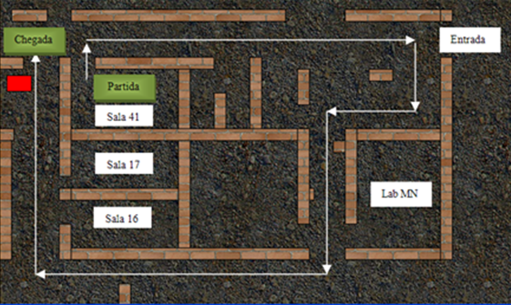
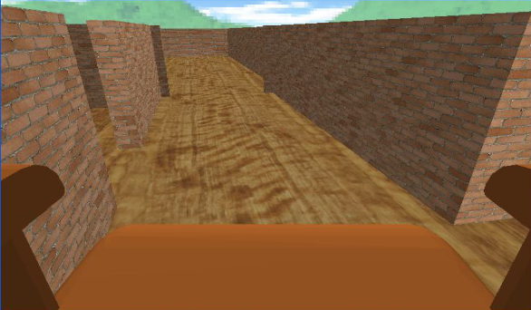
IntellWheels Simulator
UDP/IP communication
Collision Detection
Robot Body Modeling
XML Message Parsing
Virtual Sensor Value Calculation
Motor Modeling & Robot Position Calculation
Virtual World Modeling
Viewer Agent 1
Virtual Wheelchair Agent 1
Viewer Agent 2
Virtual Wheelchair Agent 2
Real Wheelchair Agent 1
Door Agent
Advantages:
  Fast evaluation of new methodologies
  Tool for training patients in a safe
  environment
  Interact with virtual objects and
  virtual IW
Virtual world (2D View)
Simulation - First Person View

Slide 16
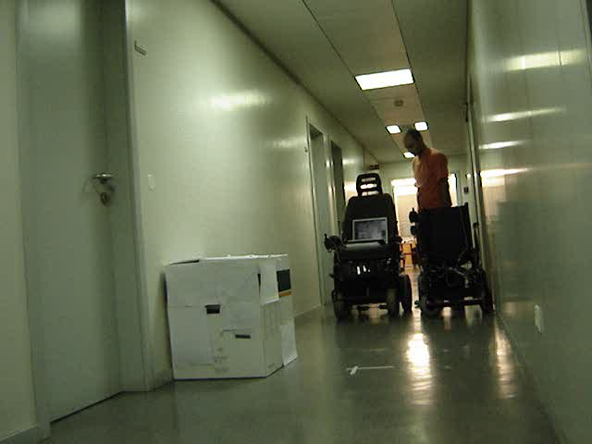
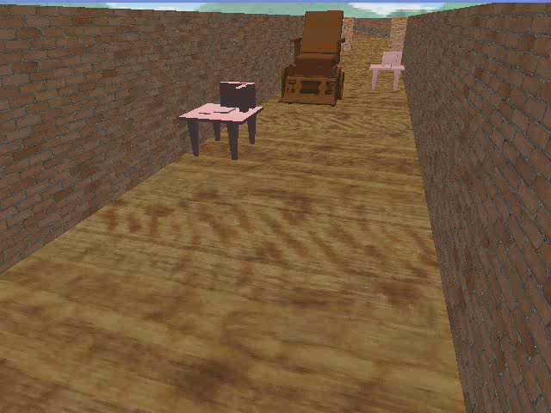
IntellWheels Simulator
Real Environment
  No Connection to virtual information
Augmented Reality
  Virtual objects interfere with real world
Augmented Virtuality
  Real objects interfere with virtual world
Virtual Environment
  No connection with real world information
Real Environment
Augmented Reality
Augmented Virtuality
Virtual Environment

Slide 17




IntellWheels Multimodal Interface
Which interaction is best adapted to wheelchair patients ?
  Several patient-wheelchair interfaces were proposed in the literature
OR
OR
OR
OR
...
Joystick / Buttons
Standard
Facial Expressions
OSAKA IW
Voice Commands
MIT IW
Head Gestures
RoboChair IW
Inputs for patient-wheelchair interaction

Slide 18

IntellWheels Multimodal Interface
There is no single input well adapted for all physical limitations
  IntellWheels combines user inputs (e.g. speech, pen, touch, manual gestures) in a coordinated manner with multimedia system output
...
Joystick / Buttons
Facial Expressions
Voice Commands
Head Gestures
Integrated inputs for the IntellWheels patient-wheelchair Multimodal Interface

Slide 19
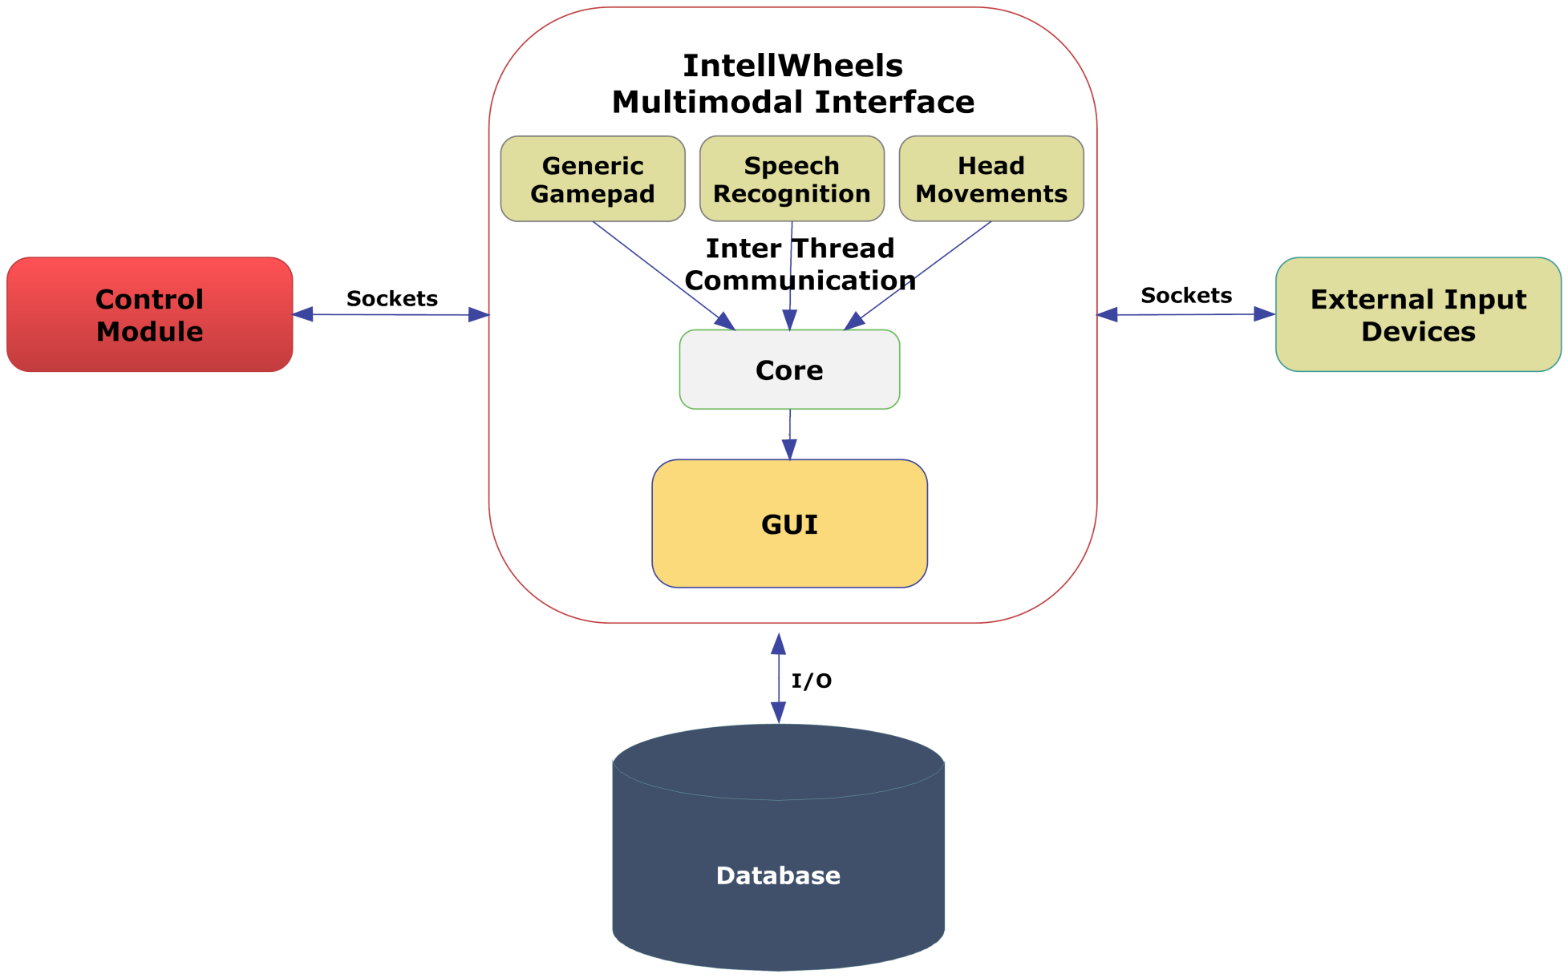
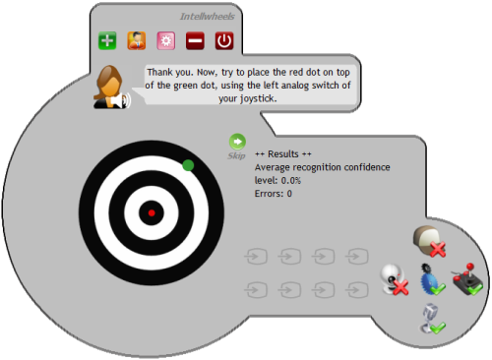
IntellWheels Multimodal Interface
Advantages:
  Natural and transparent interaction style
  Flexibility depending on the user and context
  Adaptable to each user: User defined input sequences
  Freely associated to wheelchair output actions and interface actions
  Friendly Graphical User Interface
Action:
Wheelchair goes to Room
Blink Left Eye
Say “Go”

Slide 20
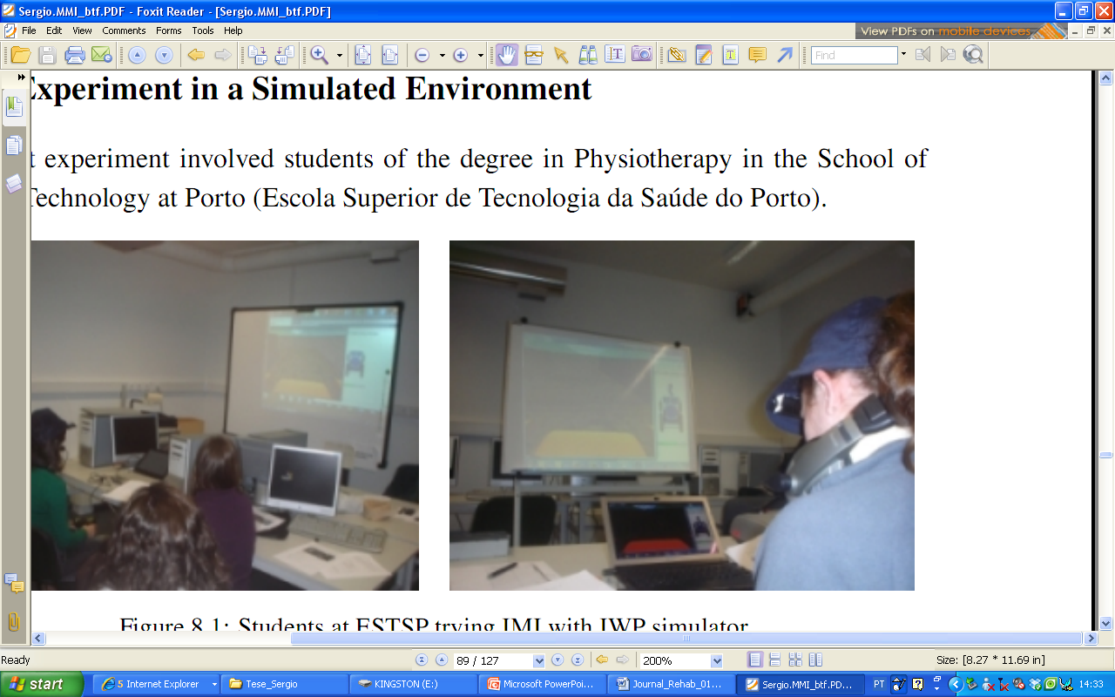
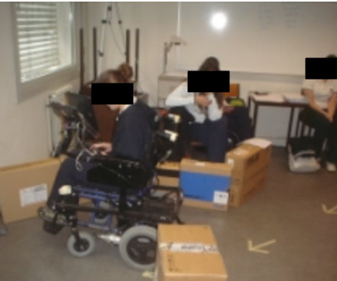
Experiments and Results
Simulator and Intellwheels prototype were used for testing the IW usability
  46 individuals performing the experiment with a simulated IW
  12 individuals performing the experiment with a real IW
Application of a questionnaire with the System Usability Scale (SUS)
UbiSense System for IW tracking (40 Hz)

Slide 21
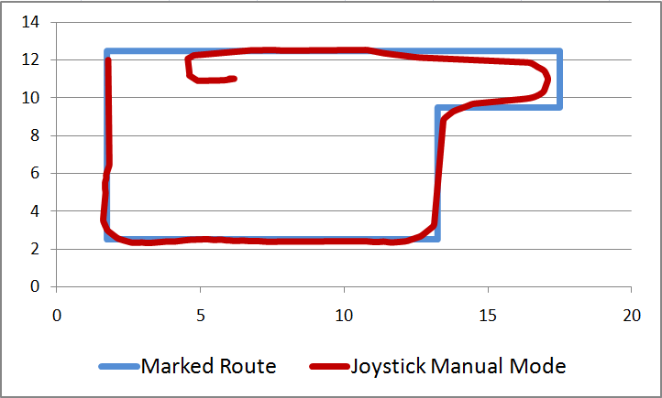
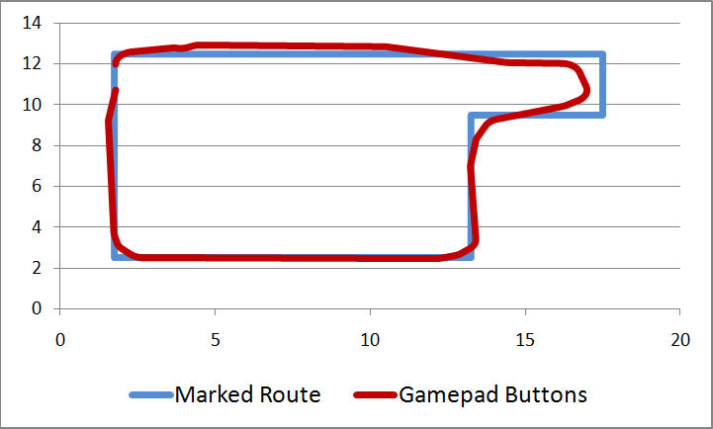
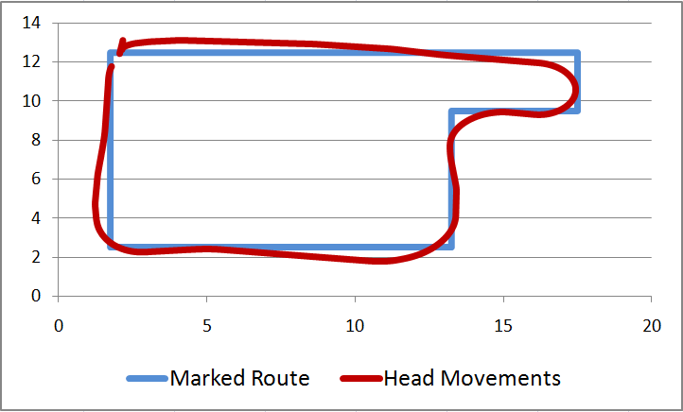
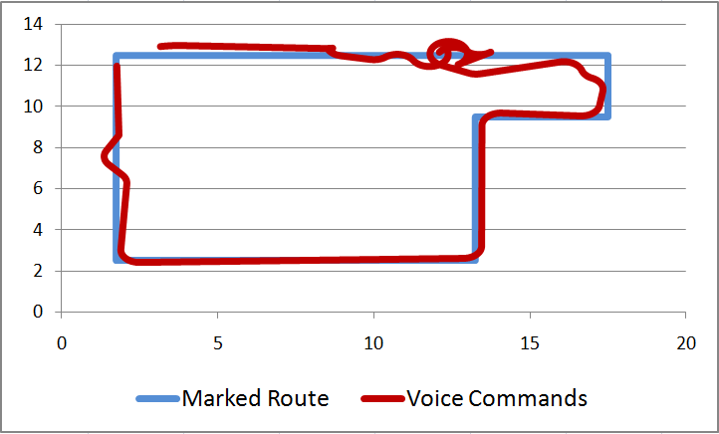
Experiments and Results

Slide 22
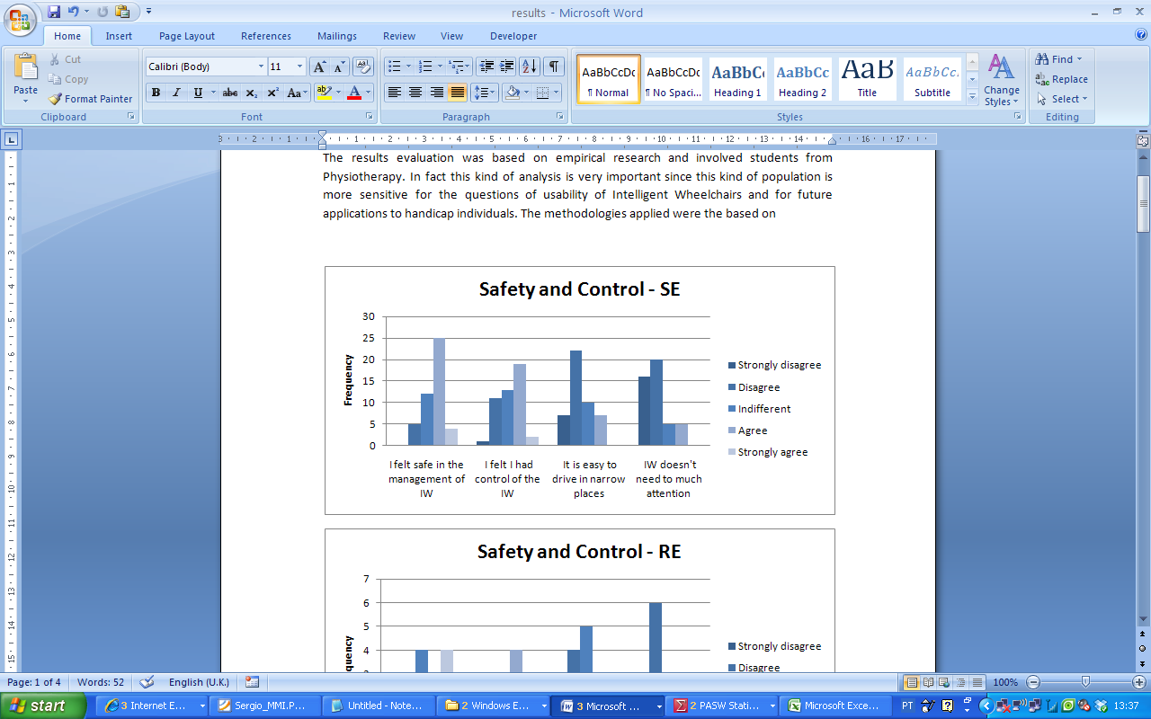
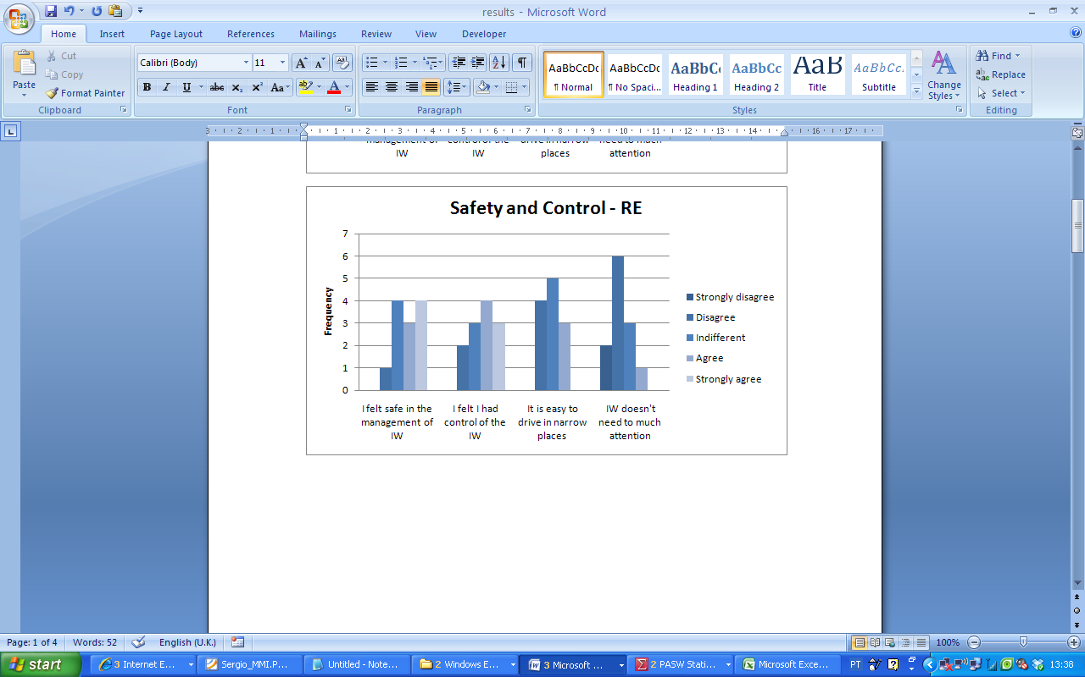
Experiments and Results
Usability of the Intelligent Wheelchair in real environment is higher than in the simulated environment
  SUS Mean Score
    63 in Simulated Experiment
    77 in Real Experiment
  No statistical evidences to affirm that are differences between real and simulated environment in terms of safety and control of the IW
  Most of the users considered the multimodal way of driving the wheelchair very practical and satisfactory

Slide 23
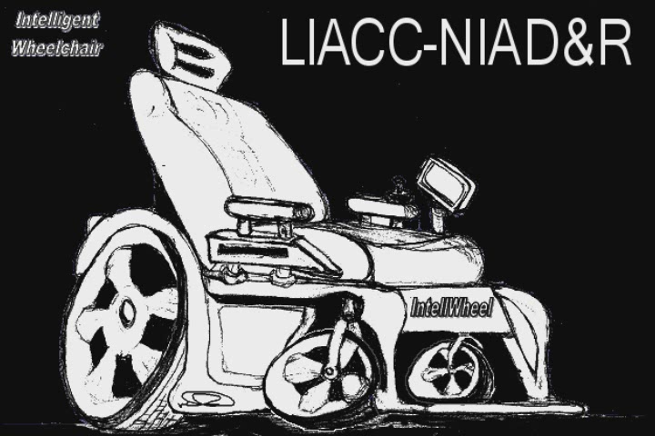
Experiments and Results

Slide 24

Experiments and Results

Slide 25
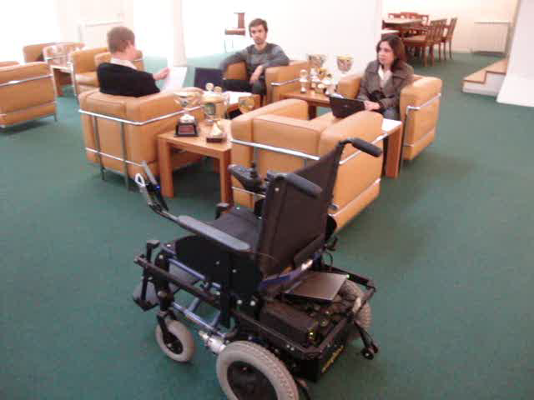
Experiments and Results

Slide 26
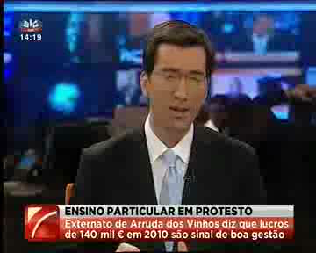
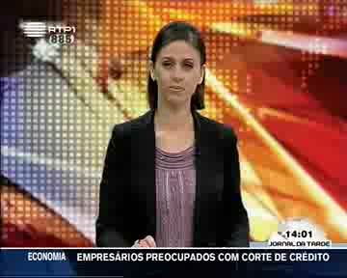


IntellWheels in the Media

Slide 27
Awards
FCT Funding (FCT/RPID/ADA/109636/2009)
  INTELLWHEELS - Intelligent Wheelchair with Flexible Multimodal Interface was awarded with RIPD/ADA/109636/2009 FCT funding, €94,360 (July 2010)
FreeBots – Festival Nacional de Robótica 2011
  INTELLWHEELS got 2nd Place at FreeBots 2011 competition (held at Festival Nacional de Robótica 2011), IST, Lisbon, April 2011
Galardão da Inclusão – Investigação Aplicada
  INTELLWHEELS - Intelligent Wheelchair with Flexible Multimodal Interface was awarded with Galardão da Inclusão, Investigação Aplicada, at Gala da Inclusão, I.P.Leiria, Leiria, December 2011
Prémio da Associação Salvador
  INTELLWHEELS was awarded with 2nd Place (1st Menção Honrosa) at Prémios da Associação Salvador “Ser Capaz”, (3500 Eur – 35% of the total awarded money), January 2012

Slide 28
Conclusions
Platform to Develop Intelligent Wheelchairs
  Transformation of electric Wheelchairs into an Intelligent Wheelchair
  Low cost, low ergonomic impact
  Simulation with mixed reality support
Multimodal Interface
  Flexible Multimodal Interface – combination of multiple inputs
  User may define his own communication/command language
Collaboration with Health Institutions (FCT/RPID/ADA/109636/2009)
  Project started July 2010
  ESTSP/IPP – School of Allied Health Science of Porto
  APPC – Portuguese Association for Cerebral Palsy
Scientific Project Ends August 2012
  Spinoff - Commercial Product?
  European Project to further develop the concept?

Slide 29
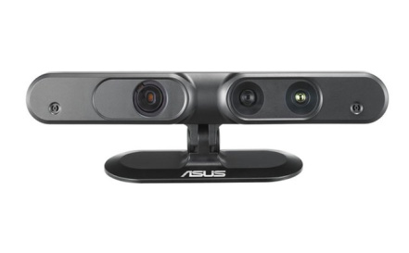
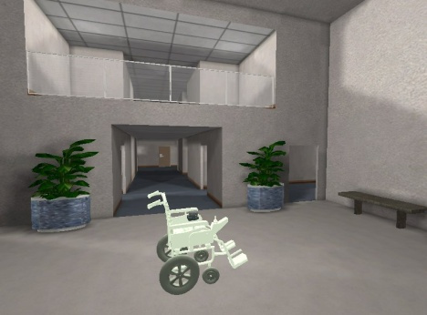
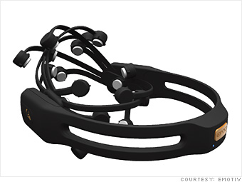
Future/Ongoing Work
Prototypes / Hardware
  New prototype under development
  ASUS Xtion for mapping and obstacle avoidance
Simulation
  New simulator based on Usarsim
Multimodal Interface
  Eye Gaze Tracking
  Facial Expression recognition
  Brain Computer interface
Automatic Wheelchair configuration
  Patient Modelling
  Machine Learning
Experiments with real patients (FCT/RPID/ADA/109636/2009)
  ESTSP/IPP –School of Allied Health Science of Porto
  APPC – Portuguese Association for Cerebral Palsy

Slide 30
Main Publications
Journals and Book Chapters
Braga, Rodrigo. A.M., Petry, M.R., Moreira, A.P., Reis, L.P. (2011) IntellWheels: A Modular Development Platform for Intelligent Wheelchair. JRRD - Journal of Rehabilitation Research and Development, IF: 1.36 (accepted Dec 2010)
Silva, Daniel Castro; Braga, Rodrigo A. M.; Reis, Luís Paulo; Oliveira, Eugénio (2011): Designing a Meta-Model for a Generic Robotic Agent System using GAIA Methodology . Information Sciences, Elsevier, IF: 3.29 (accepted Dec 2010)
Braga, Rodrigo A. M.; Petry, Marcelo; Moreira, Antonio Paulo; Reis, Luís Paulo (2009): Concept and Design of the Intellwheels Platform for Developing Intelligent Wheelchairs. Informatics in Control, Automation and Robotics, Lecture Notes in Electrical Engineering, 2009, Volume 37, Part 3, pp. 191-203
Conference Proceedings (Indexed at ISI Web of Knowledge)
Petry, Marcelo R.; Moreira, Antonio Paulo; Braga, Rodrigo A. M.; Reis, Luis Paulo (2010): Shared control for obstacle avoidance in intelligent wheelchairs, IEEE Conference on Robotics, Automation and Mechatronics, RAM 2010, pp. 182-187, 201
Silva, Daniel Castro; Braga, Rodrigo A. M.; Reis, Luís Paulo; Oliveira, Eugénio (2010): A generic model for a robotic agent system using GAIA methodology: Two distinct implementations, IEEE Conference on Robotics, Automation and Mechatronics, RAM 2010, pp. 280-285, 2010
Frederico M. Cunha, Rodrigo A. M. Braga, Luís Paulo Reis (2010): Evaluation of a Communication Platform for Safety Critical Robotics. Artifical Intelligence and Soft Computing, 10th Int. Conf. ICAISC 2010, Poland, June 13-17, 2010, LNCS 6114, Springer , pp.239-246
Cunha, Frederico M.; Braga, Rodrigo A. M.; Reis, Luís Paulo (2010): A Cooperative Communications Platform for Safety Critical Robotics: An Experimental Evaluation. PAAMS 2010, Advances in Soft Computing, Springer, Vol.70, pp.151-156
Reis, Luís Paulo; Braga, Rodrigo A. M.; Sousa, Márcio; Moreira, António Paulo (2009): IntellWheels MMI: A Flexible Interface for an Intelligent Wheelchair. RoboCup 2009: 13th annual RoboCup Int. Symposium, Graz, Austria, June 29 - July 5, LNCS 5949, Springer, pp. 296-307
Braga, Rodrigo A. M.; Malheiro, P. Reis, L.P. (2009): Development of a Realistic Simulator for Robotic Intelligent Wheelchairs in a Hospital Environment. RoboCup 2009: 13th RoboCup Int. Symposium, Graz, Austria, June 29 - July 5, LNCS 5949, Springer, pp. 23-34
Braga,R. A.M., Petry, M.R., Moreira, A.P., Reis, L.P. (2008).“ ntellwheels: A Development PlatForm for intelligent wheelchairs for disabled people. 5th ICINCO 2008 – Int. Conference on Informatics in Control, Automation and Robotics.Vol I. pp.115-121. Funchal, Madeira, Portugal. May 11-15, 2008.
Braga, R. A.M., Petry, M.R., Reis, L.P, Oliveira, E. (2008). Multi-Level Control of an Intelligent Wheelchair in a Hospital Environment using a Cyber-Mouse Simulation System. ICINCO 2008 - Int. Conf. Informatics in Control, Aut. and Robotics. Vol II. pp.179-182,Funchal,Madeira, Portugal. May 11–15, 2008.
Faria, P. M. ; Braga, R. A. M.; Valgôde E. ; Reis L. P.(2007). Interface Framework to Drive an Intelligent Wheelchair Using Facial Expressions. In: Proc. IEEE International Symposium on Industrial Electronics, 2007, Vigo. IEEE International Symposium on Industrial Electronics, 2007. pp. 1791-1796.
Faria, P. M. ; Braga, R. A. M.; Valgôde E. ; Reis L. P.(2007). Platform to Drive an Intelligent Wheelchair Using Facial Expressions. Proc. 9th International Conference on Enterprise Information Systems - Human-Computer Interaction (ICEIS 2007) 2007: pp.164-169

Slide 31
Other Publications
Other Publications
Martins, Bruno; Valgode, Eduardo; Faria, Pedro; Reis, Luís Paulo (2006). Multimedia Interface with an Intelligent Wheelchair. In João M. Tavares and Renato N. Jorge (eds.) Proc. of CompImage 2006 – Computational Modelling of Objects Represented in Images: Fundamentals Methods and Applications, Coimbra, Portugal, 20-21 October, 2006, Taylor & Francis Group, London, UK, pp. 267-274, 2007, ISBN: 978-0-415-43349-5
Faria, Pedro Miguel; Reis, Luís Paulo (2007). An Approach to a Wheelchair Driving System using Facial Expressions. Proceedings da 2ª Conferência em Metodologias de Investigação Científica (Comic07). pp. 33-43. Porto, Portugal, February 1-2, 2007
Sousa, Márcio; Braga, Rodrigo A. M; Reis, Luís Paulo (2008). Multimodal Interface for an Intelligent Wheelchair. Proc. 3rd International Workshop on Intelligent Robotics, IROBOT 2008, October 14th. pp. 95-116 .Lisbon University Institute – ISCTE, Lisbon, Portugal, 2008.
Malheiro, Pedro; Braga Rodrigo A. M.; Reis, Luís Paulo (2008). Intellwheels Simulator: A Simulation Environment for Intelligent Wheelchairs. Proc. 3rd International Workshop on Intelligent Robotics , IROBOT 2008, October 14th. pp. 117-128. Lisbon University Institute – ISCTE, Lisbon, Portugal, 2008.
Braga, R.A.M., Petry, M.R., Moreira, A.P., Reis, L.P. (2008). Platform for Intelligent Wheelchairs Uusing Multi-level Control and Probabilistic Motion Model. 8th Portuguese Conference on Automatic Control, Controlo 2008, pp.833-838, Vila Real, Portugal. July 21–23,2008.
Braga, R.A.M., Rossetti, R.J.F. Reis, L.P., Oliveira, E. (2008). Applying multi-agent systems to simulate dynamic control in flexible manufacturing scenarios, in Agent-Based Modeling and Simulation Symposium, 19th European Meeting on Cybernetics and Systems Research. Vienna, March 25-28, 2008. Trappl, R. (Ed.) Cybernetics and Systems. Vienna: Austrian Society for Cybernetic Studies. v.2, pp.488-493
Petry, Marcelo; Braga, Rodrigo; Reis, Luís Paulo; Moreira, António Paulo (2010). Real-Time Obstacle Avoidance for Intelligent Wheelchairs . Proceedings of the 5th Doctoral Symposium on Informatics Engineering 2010 (DSEI’10), Porto, Portugal, 28-29 January, pp. 67-78
Faria, Brígida Mónica; Lau, Nuno; Reis, Luís Paulo (2010). An Approach for Classification of Patients and Users of an Intelligent Wheelchair using Data Mining, ICH - I International Health Congress Gaia-Porto, Vila Nova de Gaia, Portugal, September 23-25, 2010
PhD and MSc Thesis
Rodrigo A.M. Braga, Plataforma de Desenvolvimento de Cadeiras de Rodas Inteligentes, PhD Thesis, PRODEI, FEUP, November 2010
Marcelo Roberto Petry, Desenvolvimento do Protótipo e Controlo de uma Cadeira de Rodas Inteligente, MSc Thesis - MIEEC, February 2008
Pedro Miguel Castro Malheiro, Intelligent Wheelchair Simulation, MSc Thesis - MIEEC, July 2008
Márcio Miguel Couto de Sousa, Multimodal Interface for an Intelligent Wheelchair, , MSc Thesis - MIEEC, July 2008
José Carlos Pinto Miranda, Sistema de Visão para Controlo de Cadeira de Rodas Inteligente, MSc Artificial Intelligence and Intelligent Systems (FEUP and FEP), December 2009
Sérgio Miguel Fontes Vasconcelos, Multimodal Interface for an Intelligent Wheelchair, MSc Thesis - MIEIC, February 2011

Slide 32
IntellWheels:
Intelligent Wheelchair with Flexible Multimodal Interface
Principal Investigator: Luís Paulo Reis, PhD
(lpreis@fe.up.pt)
Main Researchers: António Paulo Moreira (PhD), Rodrigo Braga (PhD), Marcelo Petry (MSc), Brígida Mónica Faria (MSc), Sérgio Vasconcelos (MSc)

