Slide 1

Lisbon study visit
Francisco Nunes, Manager, FEI Division, MA COMPETE (FIN-EN Partner nr. 12)
Lisbon, September 26th, 2013

Slide 2
Summary
1.
Portugal economic and demographic main characteristics and indicators
2.
Overview: FIN-EN Project
3.
Overview: COMPETE and FEI supported by the MA

Slide 3
1.
Portugal economic and demographic main characteristics and indicators

Slide 4
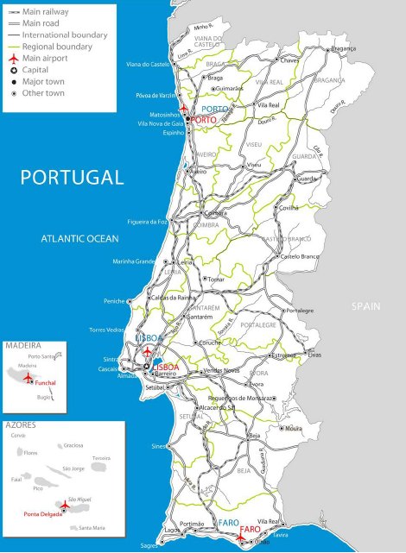
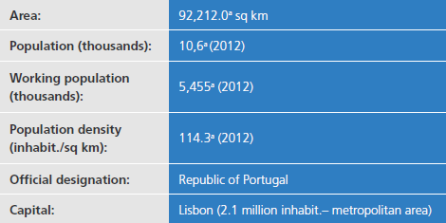
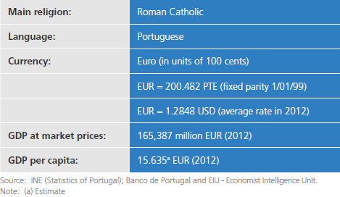
Basic Data
Source: AICEP (Portuguese Trade & Investment Agency) – Portugal Basic Data – June 2013

Slide 5
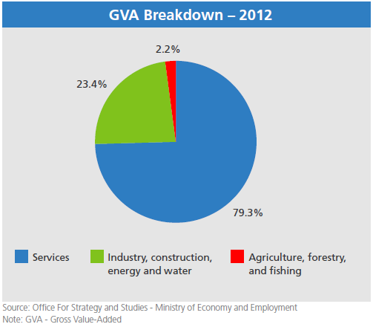
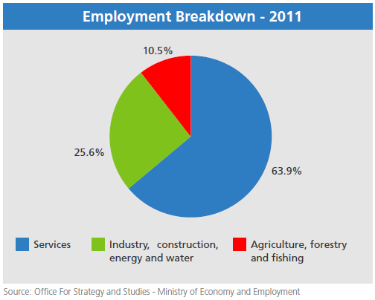
Economic structure
Source: AICEP (Portuguese Trade & Investment Agency) – Portugal Basic Data – June 2013

Slide 6
2.
Overview: FIN-EN Project

Slide 7
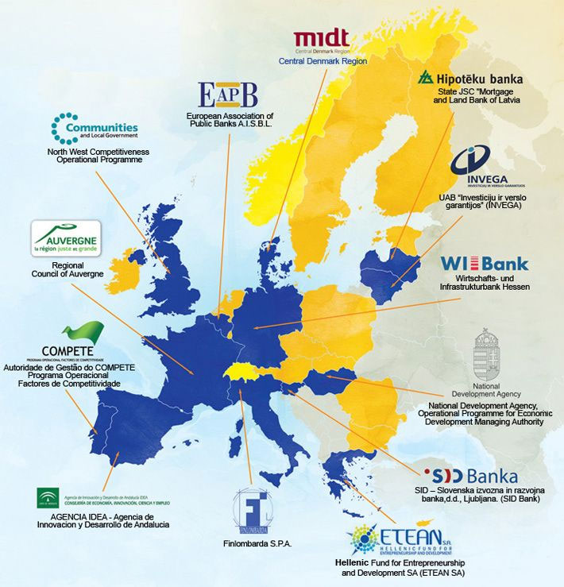
FIN-EN Project
INTERREG Project with the objective: sharing methodologies and intensifying cooperation between EU national and regional authorities, about the best practices, through EU funding, to support FEI for enterprises (without the intervention of EIF)
FEI studied: risk capital, guarantees and loans
Participants: 13 institutions - each representing a different EU Region and Member State
From 01/01/2012 to 31/12/2014

Slide 8
FIN-EN Project WBS
Thematic Working Groups
TWG1
FEI Programming
TWG2
FEI Implementation
TWG3
FEI Monitoring/ Reporting
FEI Life Cycle Macro-Phases
Study Visits
(to enhance knowledge sharing of some participants’ best practices)
Portugal
France
Greece

Slide 9
3.
Overview: COMPETE and FEI supported by the MA

Slide 10
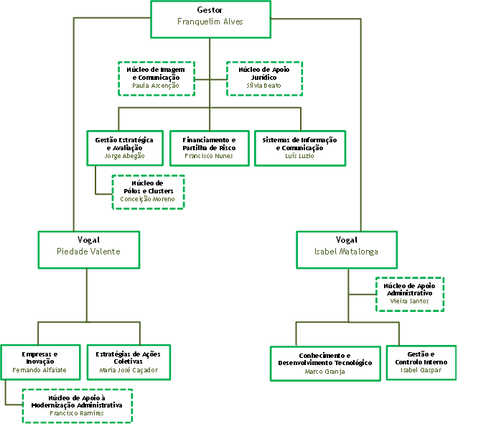
COMPETE
Function: Managing support instruments, financed by ERDF
Aim: Convergence regions (North, Center and Alentejo)
Core business areas:
- FEI;
- Incentives to private investment;
- Incentives to public investment;
- Incentives to R&D;
- Incentives to collective actions.

Slide 11
COMPETE – FEI Division
Team Structure
Top Management
Franquelim Alves
Piedade Valente
FPR – Finance and Risk Sharing Area of MA COMPETE
Middle Management
Francisco Nunes
Primary Role: Management, during its life cycle, of FEI supported by MA COMPETE
Technical Experts
Ricardo Banha
Marta Simão
Susana Marques

Slide 12
“Equity TYPE” FEI supported
4 VCF
Early
Stages
2 VCF
Corporate
Venture
Capital
3 VCF
Pre-seed
VCF
BA
10 VCF
Innovation &
Internationa-
lization
3 VCF
Expansion
51
BA Societies
Implemented through Holding Fund

Slide 13
“debt TYPE” FEI supported
Credit Lines “PME Investe”
Implemented through Holding Fund
Credit Line “Investe QREN”
Implemented without HF (separate block of finance)

Slide 14
FEI support structure
Actors/instruments
Back-office
Middle-office
Front-office
Actor
COMPETE
HF Manager (PME Investim.)
SPGM
VCF Managers
BA Societies
Banks
Final recipients (SME’s)
Instrument
SAFPRI
(FEI national regulation)
Holding Fund (FINOVA)
FCGM
VCF
BA Program
Credit Lines
Funding
ERDF

Slide 15
Fei supported – KPI
FEI | SME supported | Funding granted | Funding available
VCF / BA Program | 111 | 41M€ | 381M€
Credit Lines | 3.773 | 1.326M€ | 459M€
Total | 3.884 | 1.367M€ | 840M€
Only for the FEI component co-financed by MA COMPETE

Slide 16


Francisco Nunes
francisco.nunes@compete-pofc.org
http://www.pofc.qren.pt/areas-do-compete/financiamento-e-partilha-de-risco

