Slide 1


PORTUGUESE SME GUARANTEE SCHEME
FIN-EN Meeting
Sharing Methodologies on Financial Engineering for Entreprises
Lisbon, 26 September 2013
Miguel Sousa Branca
SPGM Executive Board Member

Slide 2
FILL THE MARKET GAP ON SME DEBT FINANCING …
thus strengthening the market mechanisms…
Savings
SME
Bank Intermediation
Securitization
Guarantees / Mutual Guarantees
Banks
Private Equity
Access
to Markets
Financial Rising Platforms
Equity Chain
Notes:
2

Slide 3
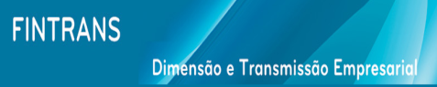

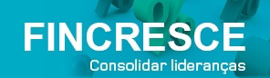
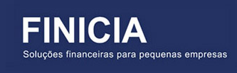
IN ALL PHASES OF THE LIFE CYCLE OF SMEs
Business Angels
Venture Capital
Turnaround
Maturity
M & A
Venture Capital
Growth
Private Equity
Start-up
Notes:
3

Slide 4

REASONS FOR GUARANTEES TO EXIST
SME are key actors in the EU economy (worldwide)
  They represent an important part of employment, gross domestic product and other macroeconomic indicators (such as exports).
Credit finance is important to SME in the EU, as they
  Have limited access to venture capital, mezzanine capital, bond issues, etc.
  Have weak own funds positions => limited capability to self-finance fixed assets investment or working capital needs
  Rely predominantly on loan finance
  Usually have a relative lack of bankable collateral
Due to the relative lack of collateral, loan finance is more difficult to obtain than for larger companies
Notes:
4

Slide 5
BUT WHY GUARANTEES?
Due to difficulties from the conventional financial system to solve the problem of failure in the credit markets, which do not get adequate funding to businesses, particularly to micro and SMEs or corporations on the early stages of their life cycle, alternative banking coverage risk mechanisms have been created;
Among these mechanisms, one should highlight the credit guarantee scheme for SMEs, based on specialised institutions in covering (usually partially) bank credits to SMEs;
In most cases these schemes put together private and public entities and respective funding;
The Portuguese Mutual Guarantee Scheme consists of a public and private partnership: mutual guarantee societies which get a public counter guarantee from a public Fund.
This Guarantee Scheme facilitates access to finance by providing credit default guarantees for SME that
  Are economically reliable
  But do not count on sufficient collateral to access bank credit

Slide 6
ADDED VALUE OF GUARANTEE SCHEMES
Advantages to SME
  Access to finance for economically reliable projects
  Recognition of qualitative factors in credit guarantee entities/ MGS risk analysis
  Not highly profit oriented
  Intermediary function of Scheme towards lender
  Participation in management of scheme
Notes:
6

Slide 7
ADDED VALUE OF GUARANTEE SCHEMES
Advantages to banks
  Reduction of bank’s risk exposure, improvement of credit quality
  Build-up of SME-Retail portfolio
  Financial supervision of MGS => Trust and sustainability vis-a-vis lending partners
  MGS provides specific sector knowledge of SME customer in addition to traditional analysis
  Specialisation in guarantee business
  Mitigation effect on risk-asset ratio, thus reduction on capital consumption by the banks
  High level of liquidity of guarantee vis-a-vis other types of collateral (usually guarantees are first demand)
Notes:
7

Slide 8
ADDED VALUE OF GUARANTEE SCHEMES
Advantages to Public authorities
  Individual risk assessment and follow-up
  Financial intermediary for public policies
  Counterguarantee element (regional, national, EIF-CIP)
  Cost effective leverage effect of MGS’ regulatory own funds
  But above all there is an important financial leverage
  of public funds
Notes:
8

Slide 9
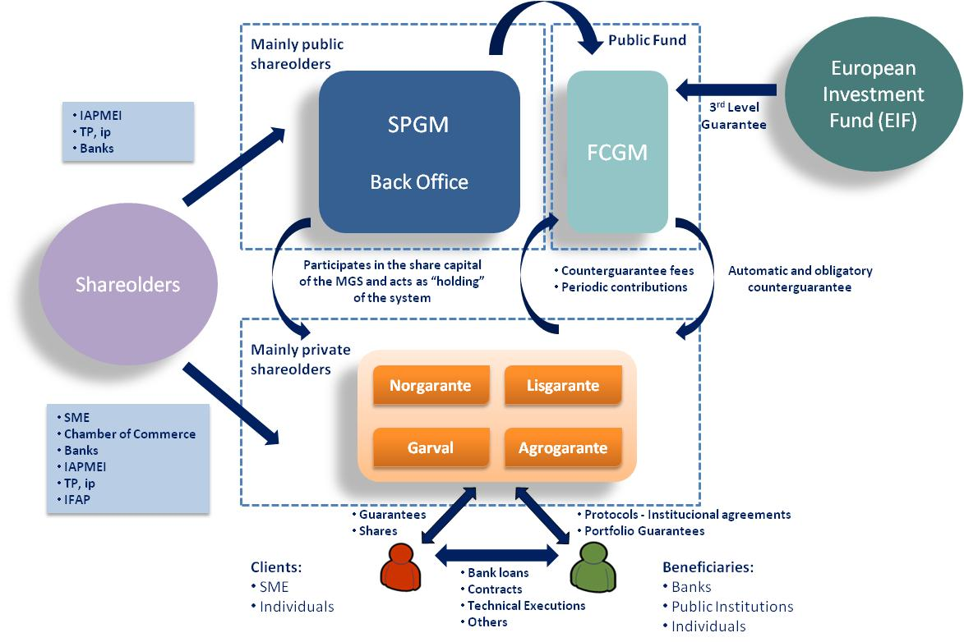
PORTUGUESE GUARANTEE SCHEME MODEL

Slide 10
MAIN FEATURES OF THE PORTUGUESE GUARANTEE SCHEME
Mutual Guarantee Societies (MGS) issue the guarantees.
  The MGS share capital is held majority by beneficiary SME (>50%), banks, SME organisations and SPGM. Thus, they are mutual and private credit institutions;
  Their scope is to support the access to finance of micro and SMEs
  [MGS also support University students and self-employed professionals];
  MGS provide on first demand financial guarantees aimed to help SMEs accessing credit in adequate price and term conditions;
  The MGS get a partial counter guarantee from the national Counter Guarantee Fund (FCGM).
  They assume their own risk analysis activities and credit decisions.
  The price of the guarantees is set according the risk appraisal results (internal rating model), inside the global boundaries defined at MGS board level (currently minimum fee of 0,5% and maximum of 4,5%, per annum on the outstanding amounts);
  They are subject to internal and external auditors;
  They are supervised by the central bank and act under a specific regulation as well as under the general banking laws (including Basel II and III).
Notes:
10

Slide 11
BASIC FEATURES OF THE PORTUGUESE GUARANTEE SCHEME
The Counterguarantee Fund (FCGM) automatically covers a part of the risk assumed by MGS.
  It has no direct contact with either SME and Banks;
  Its own funds are fully owned by the Government;
  Is doesn’t carry any kind of risk analysis on individual files as counterguarantees are by law automatic and compulsory;
  The counterguarantee levels goes from 50% to 80% of the guarantees issued by the MGS, depending on the type of product;
  The Fund is managed by SPGM;
  The Fund is audited by internal auditors, being the external one the Auditor Body of the Central Bank. It is submitted to specific auditing from tax authorities and Court of Auditors, namely in specific programmes supported by EU structural funds and/or national budget endowments and/or under a third level partial coverage of the EIF/EU programmes;
  It may get a third level guarantee that partially covers its issued cunterguarantees from the EIF under the EU different SME supporting programmes like CIP.
11
Notes:
11

Slide 12
BASIC FEATURES OF THE PORTUGUESE GUARANTEE SCHEME
SPGM acts as “Holding” of the Portuguese Guarantee Scheme.
  Manages the Counter Guarantee Fund;
  Acts as Shared Services Centre to both the Fund and all MGS;
  Represents the public interests while designing and negotiating new credit lines or other guarantee facilities;
  Negotiates with national agencies (such as IAPMEI, Tourism Agency, Ministry of Higher Education, …), and international organisations (EIF and EIB) about new credit facilities to Portuguese SME;
  Institutionally represents the Guarantee Scheme at internal organisations;
  Represents the Portuguese Guarantee Scheme internationally, namely at international organisations (European Association of Guarantee Societies – AECM and the Ibero-American Guarantee Network – REGAR).
Notes:
12

Slide 13
ACCESSING BANK CREDIT
Advantages
  Credit risk sharing (bank supplies finance but both bank and MGS assume risk)
  Collateral liquidity and reduced price volatility
  Relatively low guarantee cost (even assuming this represents an extra cost to be added to interest)
Maximum amount (by a company or group of companies)
  € 1 500 000 for bank financing (it can be higher in some specific cases)
  € 1 000 000 for technical, good execution and other non-financial guarantees
Coverage: between 50% and 80% of the bank credit amount
Costs: usually only a guarantee fee from 0,5% to 4,5% per year on the outstanding amount
Notes:
13

Slide 14

PORTUGUESE SME GUARANTEE SCHEME
SPGM – Sociedade de Investimento, S.A. (Scheme holding)
Initially (from 1994 to 2002)
SPGM mission was to examine international best practices, test the product, start working as if it were a MGS, and prepare legislation to be proposed to the Portuguese government, aimed at the creation and development of a mutual guarantee scheme, in order to facilitate and improve SME access to finance.
Notes:
14

Slide 15

PORTUGUESE SME GUARANTEE SCHEME
O SISTEMA PORTUGUÊS DE GARANTIA MÚTUA
After the first phase the MGS have been establishedand SPGM stopped issuing guarantees. From January 2003 onwards MGS are the only entities which issue guarantees.
Mutual Guarantee Societies:
Coimbra
Santarém
Lisboa
Porto
(nationwide)
(centre and Azores)
(Lisbon, south and Madeira)
(north and centre)
Agriculture, forestry and other primary sector activities
Notes:
15

Slide 16
PORTUGUESE SME GUARANTEE SCHEME - AECM
The Portuguese Mutual Guarantee System integrates the European Mutual Guarantee Association (AECM).
  The AECM has 3 main goals:
    Political Representation: AECM represents the political interest of its member organizations both towards the European Institutions, such as the European Commission, the European Parliament and Council, as well as towards other, multilateral bodies, among which the European Investment Bank (EIB), the European Investment Fund (EIF), the Bank for International Settlement (BIS), the World Bank, etc. It deals primarily with issues related to state aid regulation relevant for guarantee schemes within the internal market, to European support programmes and to prudential supervision. It has also dealt with the policy response to the financial crisis.
    Exchange of best practices: AECM serves as platform for exchange of best practices on a variety of operational issues. For this purpose, AECM has set up working groups and organizes annual seminars, operational training sessions as well as specific ad-hoc events on selected issues.
    Promotion of guarantee instrument: AECM undertakes surveys on the guarantee sector, provides relevant technical information, statistics, newsletters as well as other publications to promote the guarantee instrument. It takes part a sector representative in events both in Europe as well as beyond.
  The AECM has 40 active member organizations in 21 member states of the EU, Montenegro, Russia and Turkey.
Notes:
16

Slide 17
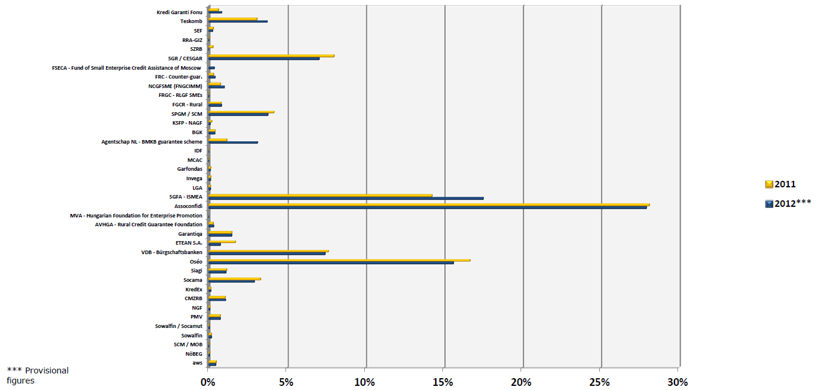
PORTUGUESE SME GUARANTEE SCHEME - AECM
Proportion of the outstanding guarantees in portfolio of each member toward AECM total: comparison 2011 and 2012 figures (in % of total AECM portfolio)
  Occupies the sixth position either to the year 2011 or 2012.
Notes:
17

Slide 18
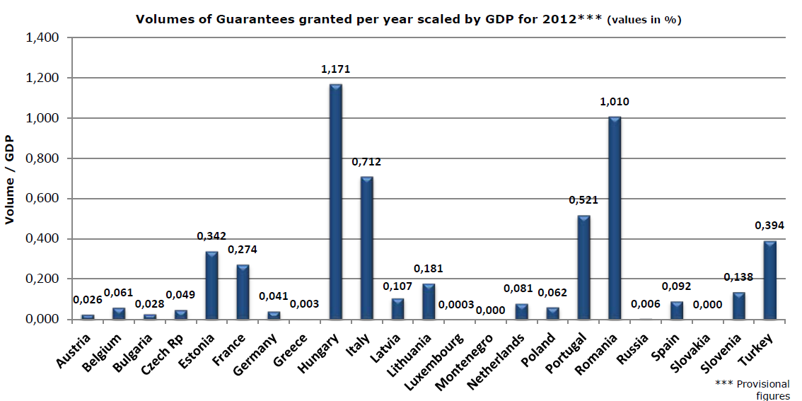
PORTUGUESE SME GUARANTEE SCHEME - AECM
Volume of guarantee activity compared to the value of economic activity
  In 2012, the SNGM appears as the fourth member of AECM with the greatest burden of production on the annual gross domestic product.
Notes:
18

Slide 19
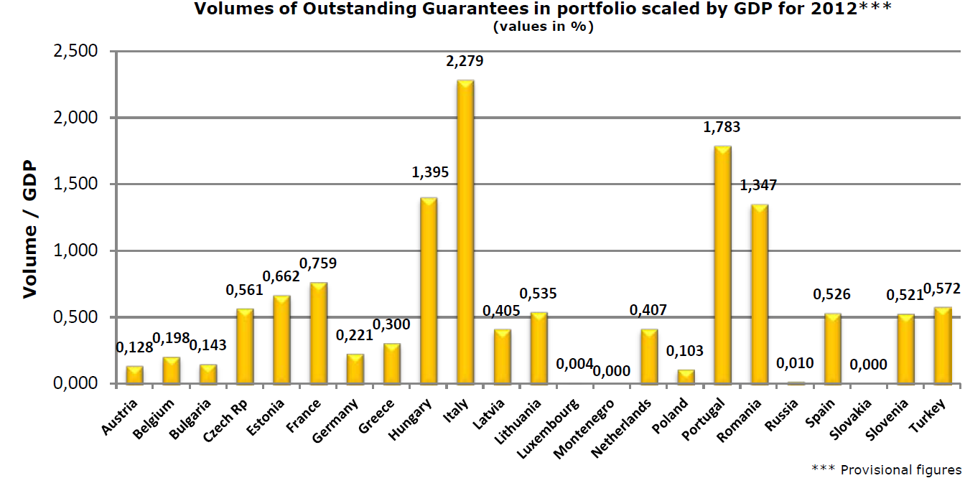
PORTUGUESE SME GUARANTEE SCHEME - AECM
Volumes of outstanding guarantees in portfolio scaled by GDP for 2012 (values in %)
  In 2012, the SNGM appears as the second member of AECM with the greater weight of the portfolio on the gross domestic product.
Notes:
19

Slide 20

DADOS ESTATISTICOS SNGM
(1994-2012)
STATISTIC DATA PMGS
(1994-2013July)

Slide 21
GROWTH DYNAMIC => SCALE
PME INVESTE
  1st edition (July/08, 750 Million euros)
  2nd edition (October/08, 1 000 Million euros)
  3rd edition (January/09, 1 800 Million euros)
  4th edition (July/09, 1 000 Million euros)
  5th edition (April/10, 750 Million euros)
  6th edition (June/10, 1 250 Million euros)
  Addendum (December/10, 1 500 Million euros)
Notes:
21

Slide 22
GROWTH DYNAMIC => SCALE
PME Crescimento
  1st edition (January/12, 1 500 Million euros + 1 000 Million euros reinforcement)
  2nd edition (January/13, 2 000 Million euros)
Investe QREN
  1st edition (October/12, 1 000 Million euros)
Notes:
22

Slide 23
GROWTH DYNAMIC => SCALE
Data: july 2013
 | PME INVESTE | PME Crescimento | PME Crescimento 2013 | Açores INVESTE | Madeira INVESTE | INVESTE Qren
Operations | 89 686 | 18 057 | 6 351 | 1 484 | 920 | 79
Global Funding Amount (*) | 10 123 | 2 052 | 506 | 71 | 79 | 27
Global Guarantee Amount (*) | 4 543 | 890 | 262 | 50 | 45 | 13,5
% Guarantee Average | 45% | 43% | 52% | 71% | 57% | 50%
* Values in Million Euros
Notes:
23

Slide 24
GROWTH DYNAMIC => INTEGRATION
Line for Entrepreneurship and Self-Employment
Ministry of Labour and Employment
Unemployed registred in IEFP
People seeking their first job
Self-employed workers, whose average monthly income as measured in the last year, is less than the national minimum wage
MICROINVEST
Credit lines with 100% of Portfolio Mutual Guarantee with a cap rate of 30%
Loans < € 15 000
Maturity 7 years and 24 months without instatements
Fixed Interest rates and guarantee fee, both subsidized by the State
Public counter guarantee of 95%
Number of Operations : 472
Guarantee Global Amount : € 1,7 Millions
Originated Employment : 697
Data
July 2013
INVEST +
Credit lines with 75% of Mutual Guarantee
Loans > € 15 000 € and < € 100 000
Maturity 7 years and 24 months without instatements
Fixed Interest rates and guarantee fee, both subsidized by the State
Public counter guarantee of 80%
Number of Operations : 1 012
Guarantee Global Amount : € 34 Milions
Originated Employment : 2 816
Notes:
24

Slide 25
GROWTH DYNAMIC => INOVATION
Data
July 2013
Loan System to Higher Education Students
Recipients: University students, Post-graduations, Phd, etc.
        Automatic credit lines opened by creditit instituitions
          Mutual Guarantee Portfolio
        1st edition (November 2007/August 2008):
          3 302 contracts/students and 40,6 million euros
        2nd edition (September 2008/August 2009):
          3 886 contracts/students and 48,8 million euros
        3rd edition (September 2009/August 2010):
          4 074 contracts/students and 45 million euros
        4th edition (September 2010/August 2011):
          4 537 contracts/students and 22 million euros
        5th edition (September 2011/August 2012):
          2 030 contracts/students and 21,8 million euros
        6th edition (September 2012/August 2013):
          1 850 contracts/students and 22,5 million euros
Notes:
25

Slide 26
Accumulated issued guarantees and outstanding portfolio OF THE SCHEME

Slide 27
Multiplying effects of Public and
Private fund allocation
Million Euros
(July 2013)
Investment made by the SME that got guarantees
€ 16 966
Guarantees Issued ⁽²⁾
€ 8 207
Public Investment
€ 1 080 ^{(**)}
Private Investment
Bank financing to SME
€ 16 493
Counter Guarantees
Issued ⁽¹⁾
€ 6 257
€ 148 ^{(*)}
Mutual SME
> 67 000
Employment
> 968 000
Nr. Students
19 679
⁽¹⁾ Includes renewals
⁽²⁾ Includes renewals and plafonds

Slide 28
Thank you very much for your attention!
www.spgm.pt

